Slide 1
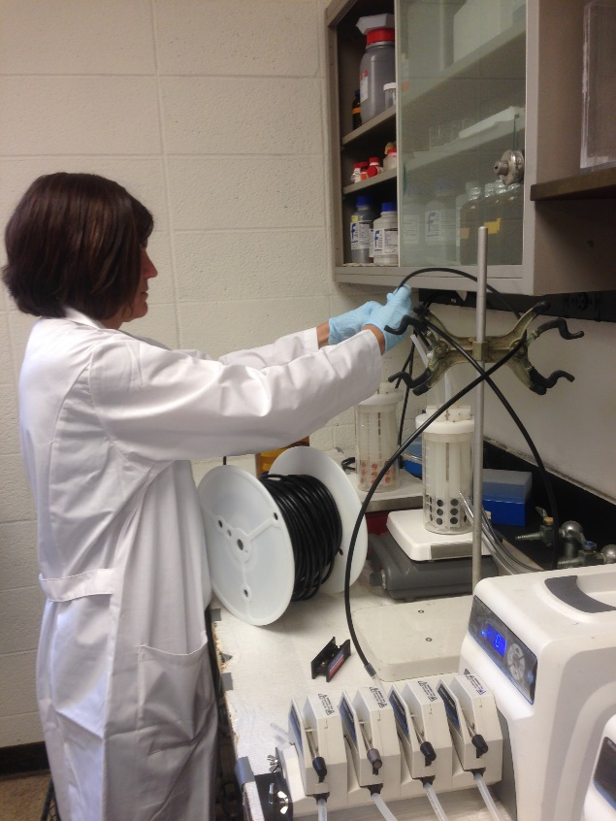
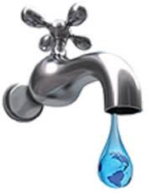
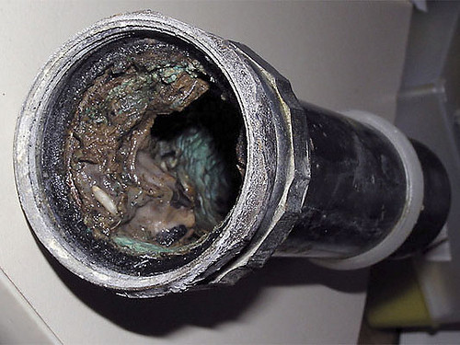
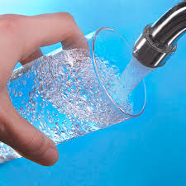
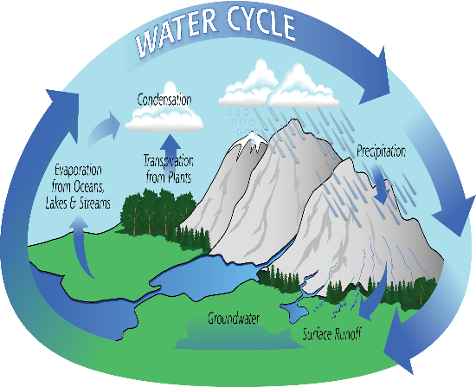
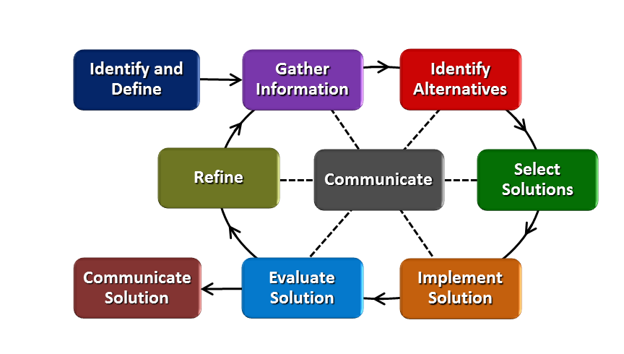
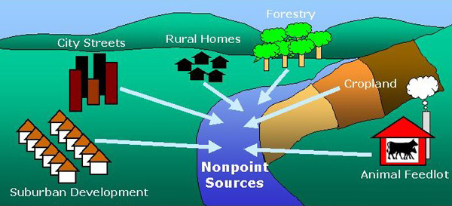
Flowing, Flowing….. Gone! Nancy Schreder-Vossen William Henry Harrison High School
RET is funded by the National Science Foundation, grant # EEC-1404766
Look what I did this summer!
Will changing your water, change
YOUR life?
What do we need to know
about Water?
Studying Biofilm Growth in Drinking Water Distribution Systems
What comes
out of your
faucet?
http://media.graytvinc.com/images/WATER+EMERGENCY.JPG
Biofilms can hold
potentially harmful
pathogens.
Which would you prefer for drinking or bathing?
http://blog.newhomesource.com/wp-content/uploads/2013/03/Fix-a-Leak-Week_faucet-with-earth-water-drop.jpg
How does water move?
http://nbcmatoday.org/uploads/banner15624151555.jpg
http://theimminentdomain.com/wp-content/uploads/2013/09/0308_
WVenvirophotos1-water-pollutions.jpg
https//www.biofilm.montana.edu/
files/CBE/images
Polyethylene Multi-Walled Carbon Nanotubules - tested to control biofilm growth.
Tttphttps://pmm.nasa.gov/education/sites/default/files/article-images/water-cycle-Art2A-medium.png
How can pollutants get added to water?
How can the Engineering Design Process be used to solve water related problems?
Biofilm reactor setup
Testing nanocomposites
Adding the coupons
http://mysticriver.org/storage/photos/nonpointsources.jpg

